Slide 1
USING PYTHON IN DATA SCIENCE
Notes:
Make sure everyone has downloaded Slack, Anaconda, and Spyder before we start.

Slide 2
I. QUICK overview of python, anaconda, and Spyder ii. Scripting & The iPython interpreter iii. Pandas A. LOADING & VIEWING DATA b. indexing and selecting data C. ASSIGNING, REASSIGNING, & SPLITTING DATA d. DESCRIBING AND SUMMARIZING DATA e. plotting data
agenda

Slide 3
Python, ANACONDA, AND SPYDER OVERVIEW
Python is a dynamically-typed scripting language popular with web applications, scientific computing, and backend / ETL work.
The focus of Python is on simplicity and code readability – with a mantra that “there should only be one obvious way to do it.”
Python is implemented via CPython, and many Python packages call C explicitly to speed up execution.
Although 5-10x faster than R, Python is typically 5-8x slower than Java due to its dynamic typing and inference.

Slide 4
Why use python?
Fast development due to concise syntax and REPL
Clear, plain language and error messages
Used in real-world production environments
Useful help() function
Lots of scientific package written in it
In most areas, matches the functionality of R

Slide 5


ANACONDA, iPython, & Spyder
Anaconda is a free Python distribution that includes all the scientific packages you need for this class.
Anaconda includes iPython, an enhanced interactive shell for scientific computing, and Spyder, a great scientific IDE for Python
Why not use iPython Notebooks? Because we want to think like software developers building for production!

Slide 6
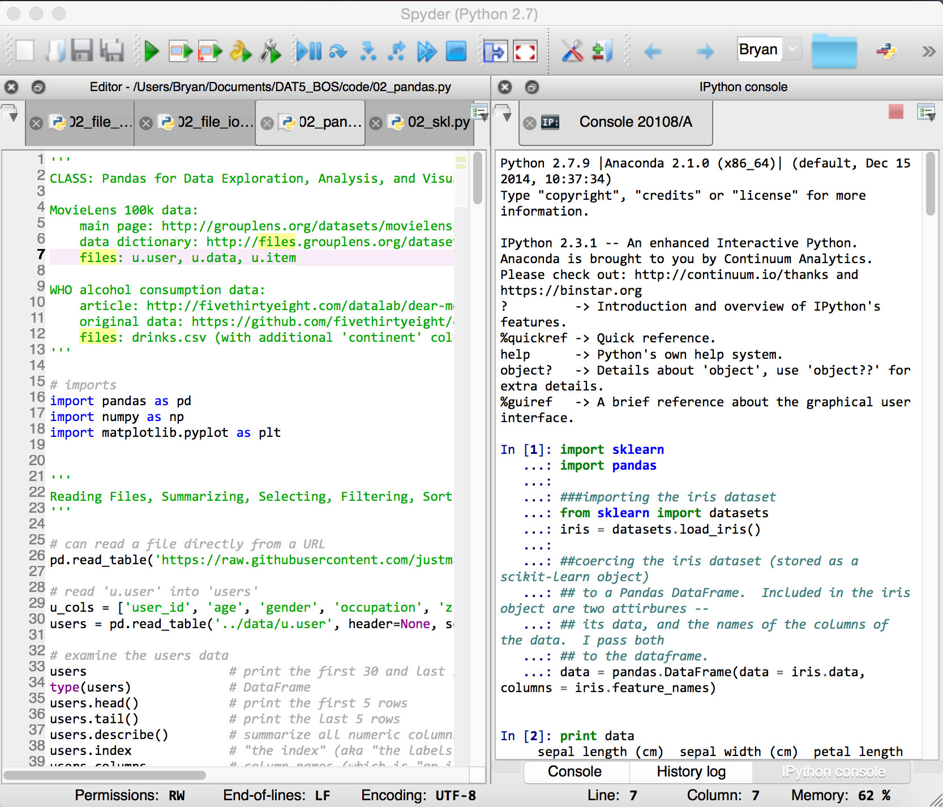
THE SPYDER IDE
Open Anaconda Launcher and select ‘spyder-app’
Your python script is to the left, and the iPython REPL (or console) is to the right.
Press Command-Enter to execute code from the editor in the console.
Automatic code completion is done using the tab key

Slide 7
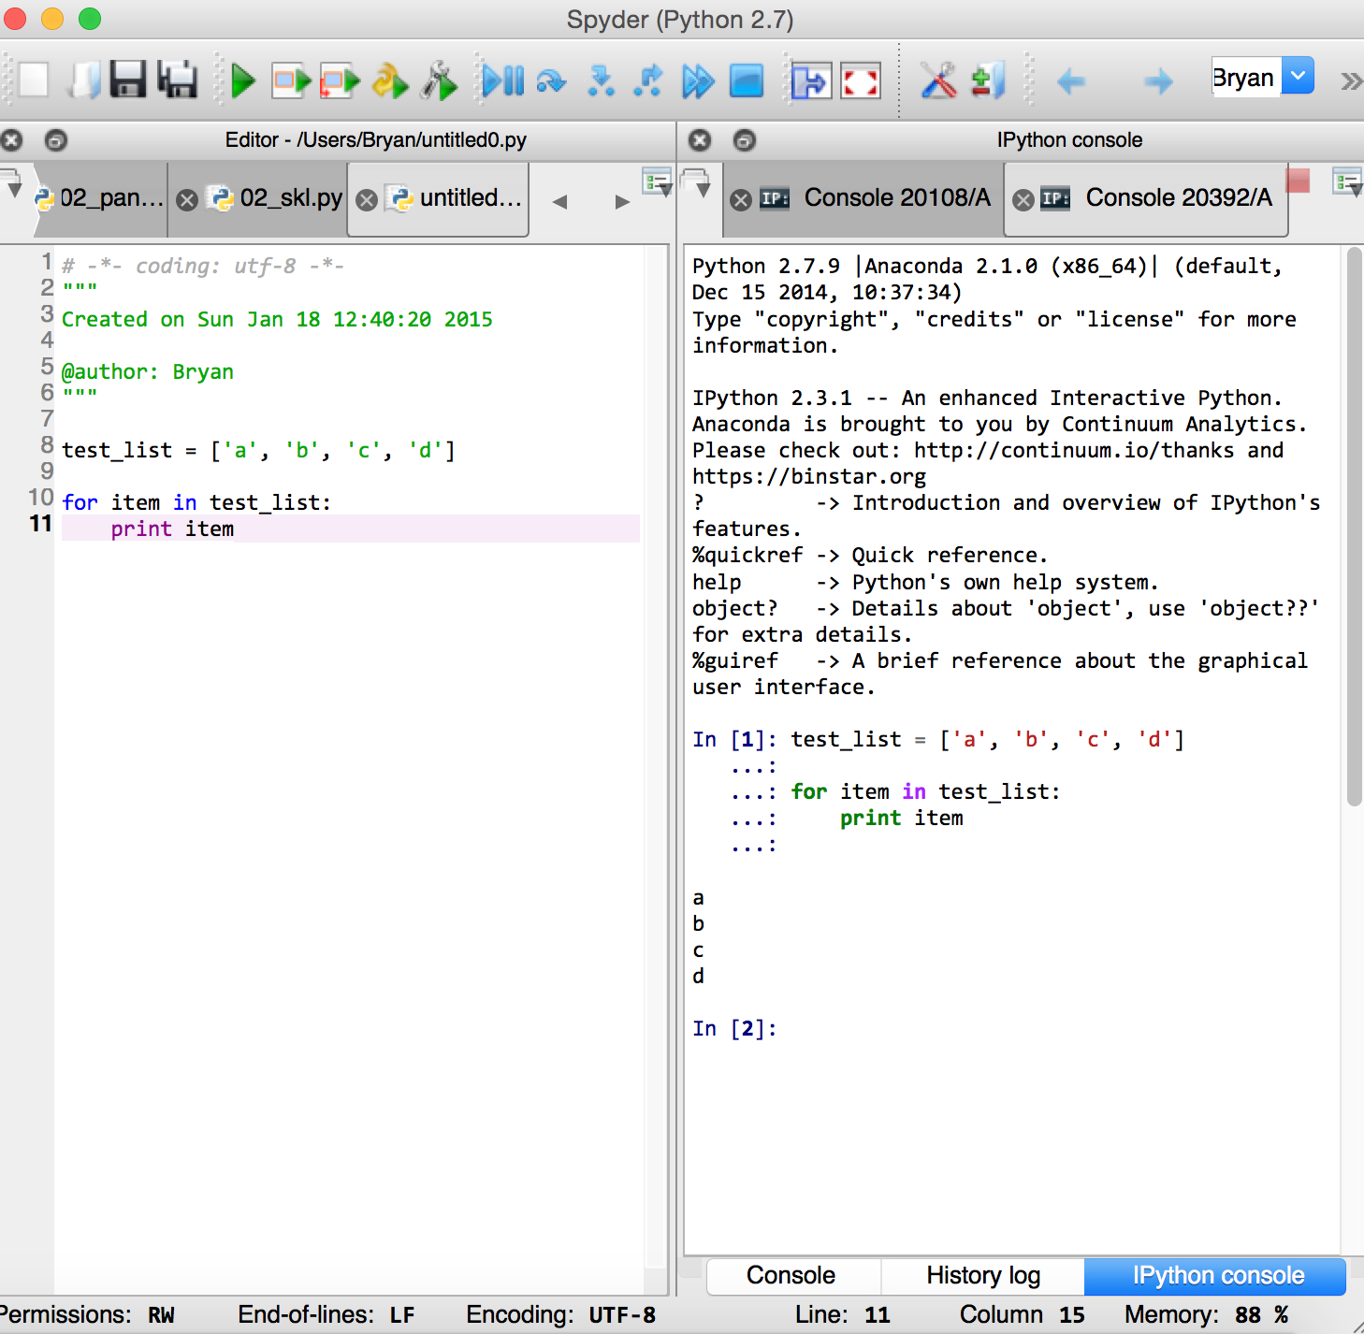
Exercise: lists and loops in Spyder
Create a new file named test.py in your ‘My Documents’ folder.
In the script:
Instantiate a list of four strings
Print the first three items in the list
Write a for loop to print out each string individually
Using tab completion, append a fifth string to the list
Run the script in the iPython console using command-enter.

Slide 8
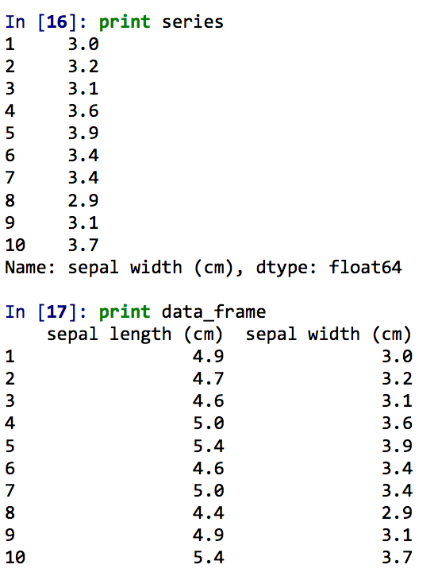
PANDAS
Unlike R, Python does not have a built-in data type for tabular data.
Pandas fills that gap with its Series and DataFrame objects.
Series and DataFrames have two basic axes: an index axis and a column index.
Series represent a single column of data, while a DataFrame represents multiple Series sharing a common index.

Slide 9
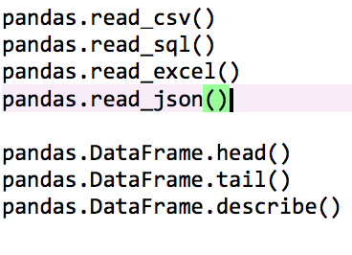
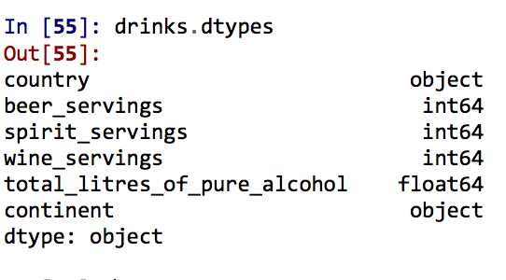
Loading and viewing data in pandas
Pandas makes loading data from external sources into DataFrames easy via its read.*() methods such as read.csv, read.sql, read.json, and read.excel.
Viewing the data in the DataFrame is also very easy to do: use the head(), tail(), and describe() functions to get an overview of the data.
Pandas data is in five basic types: int, float, Boolean, object, and category.

Slide 10
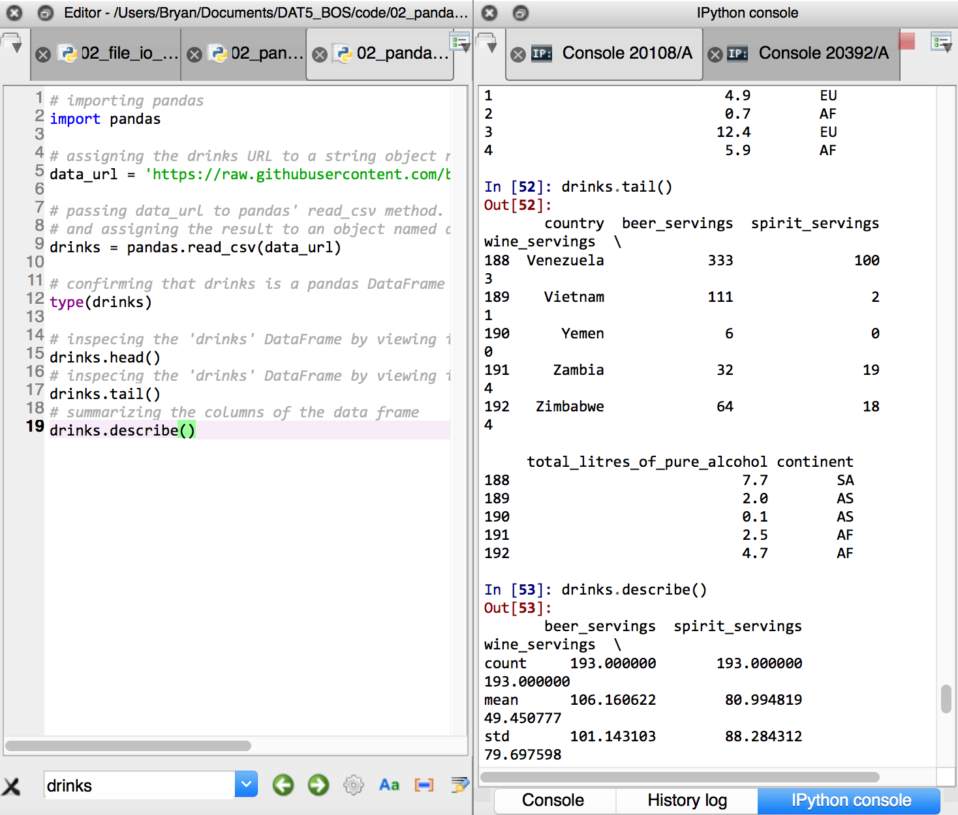
Exercise: loading and viewing data
Import Pandas
Copy and paste the URL I passed to you on Slack to the script editor.
assign it to an object named data_url.
Pass data_url to pandas’ read.csv() function and assign the results to an object named ‘drinks’.
Inspect the data with drinks.head(), drinks.tail(), and drinks.describe().

Slide 11
INDEXING AND selecting data
Pandas data is arranged along an index (rows) and columns.
There are three primary ways to access data within a DataFrame: by name, by index location, and by Boolean
Name: drinks[‘country’] or drinks.country
Index: drinks.ix[0:3, 0]
Boolean: drinks.country[drinks.index < 3]
Series use the same exact logic, except that all their operators are along a single (vertical) axis!

Slide 12
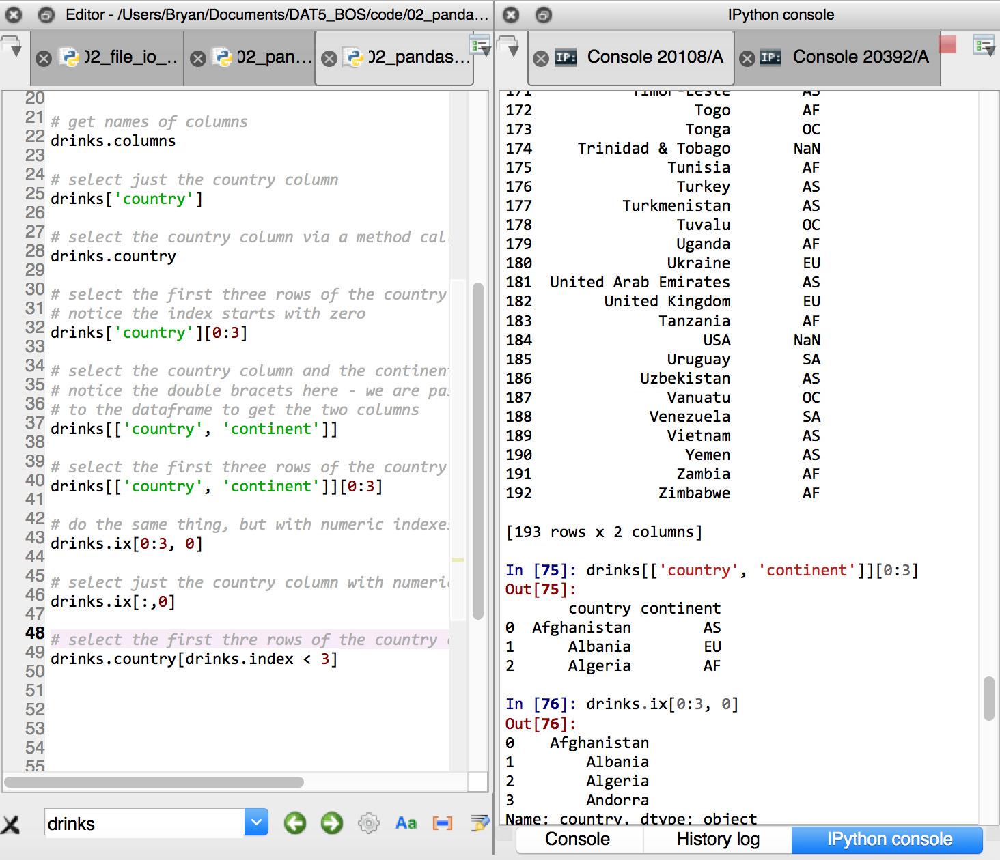
Exercise: Indexing and selecting data
Get the column names of the ‘drinks’ DataFrame via drinks.columns.
Select only the column labeled ‘country’ using selecting by name.
Select the first three rows of data in the column.
Select the ‘country’ and ‘continent’ columns in ‘drinks’.
Select the first three rows in the two columns.
Repeat the same exercise using numeric indices only.
Select the first three rows of the column ‘country’ using Boolean indexing.

Slide 13
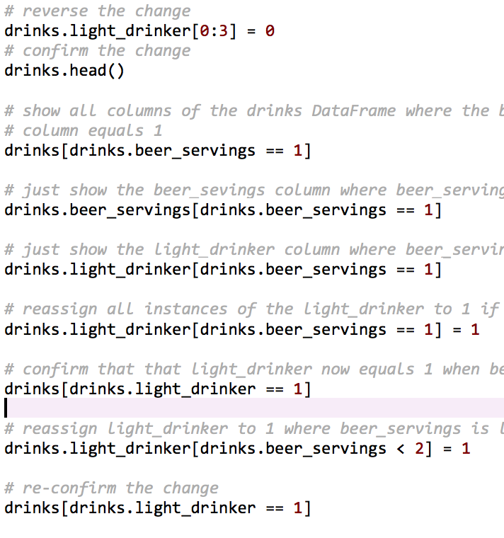
ASSIGNING, REASSIGNING, AND SPLITTING OUT DATA
New columns in a DataFrame can be arbitrarily created using the df[‘name’] = value syntax.
Data in a Series or DataFrame can be reassigned using the = sign.
You can make conditional reassignments (say, assign all instances where a row’s value equals 1 to zero) using Boolean indexing.
You can also use Boolean indexing to reassign values in one column when they equal some value in another column.

Slide 14
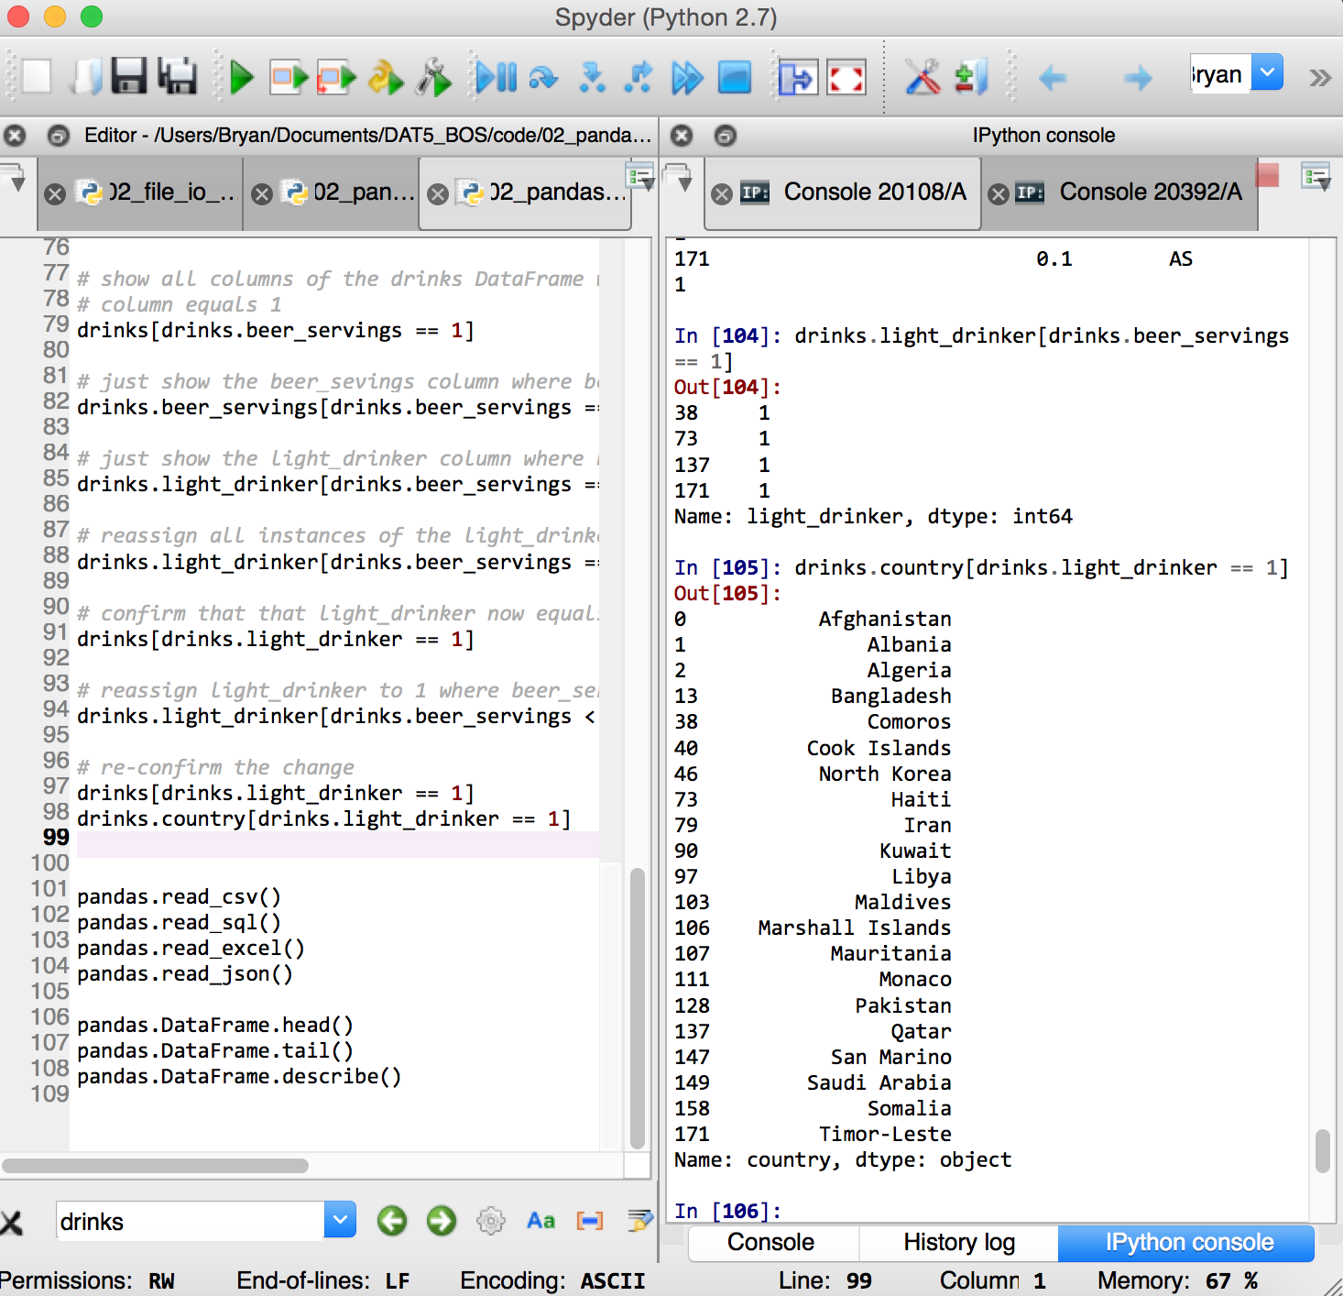
Exercise: ASSIGNING, REASSIGNING, AND SPLITTING OUT DATA
Arbitrarily create a column called ‘light_drinker’ and assign it a value of zero.
Reassign the first three rows of the light_drinker column to have 1 as their value.
Reverse this change.
Show all columns of the DataFrame where beer_servings equals 1
Reassign the light_drinker column to 1 only where beer_servings equals 1
Do the same where beer_servings is less than 2.
Confirm this change.

Slide 15
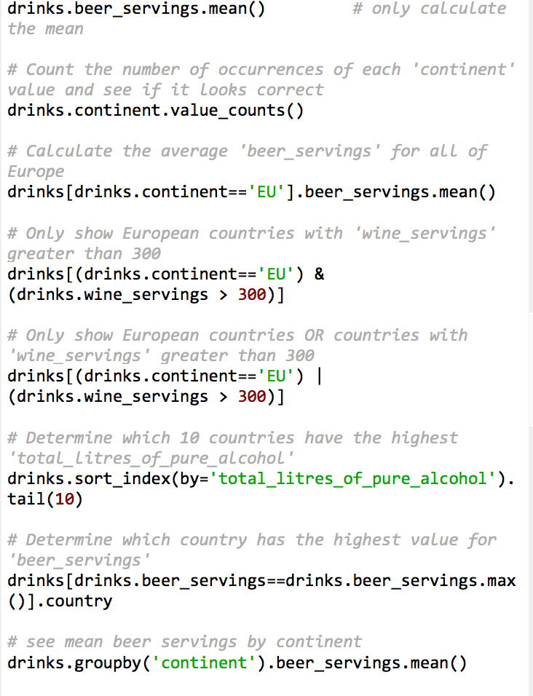
Describing and summarizing data
Use .dtypes, and .info() to understand the DataFrame object itself.
Use .describe(), .mean(), .max(), .min(), and .value_counts() to understand the data inside the DataFrame.
Combine these methods with Boolean selections to understand relationships within certain categories or values. The & (and) and | (pipe/or) operands let you do Booleans that involve multiple columns.
Use sort_index() to sort your DataFrame by a particular column.
Use .groupby() to get averages, maxes, and mins by category.
Watch out for missing values! These can be identified with .isnull(), dropped with .dropna(), and filled with .fillna().

Slide 16
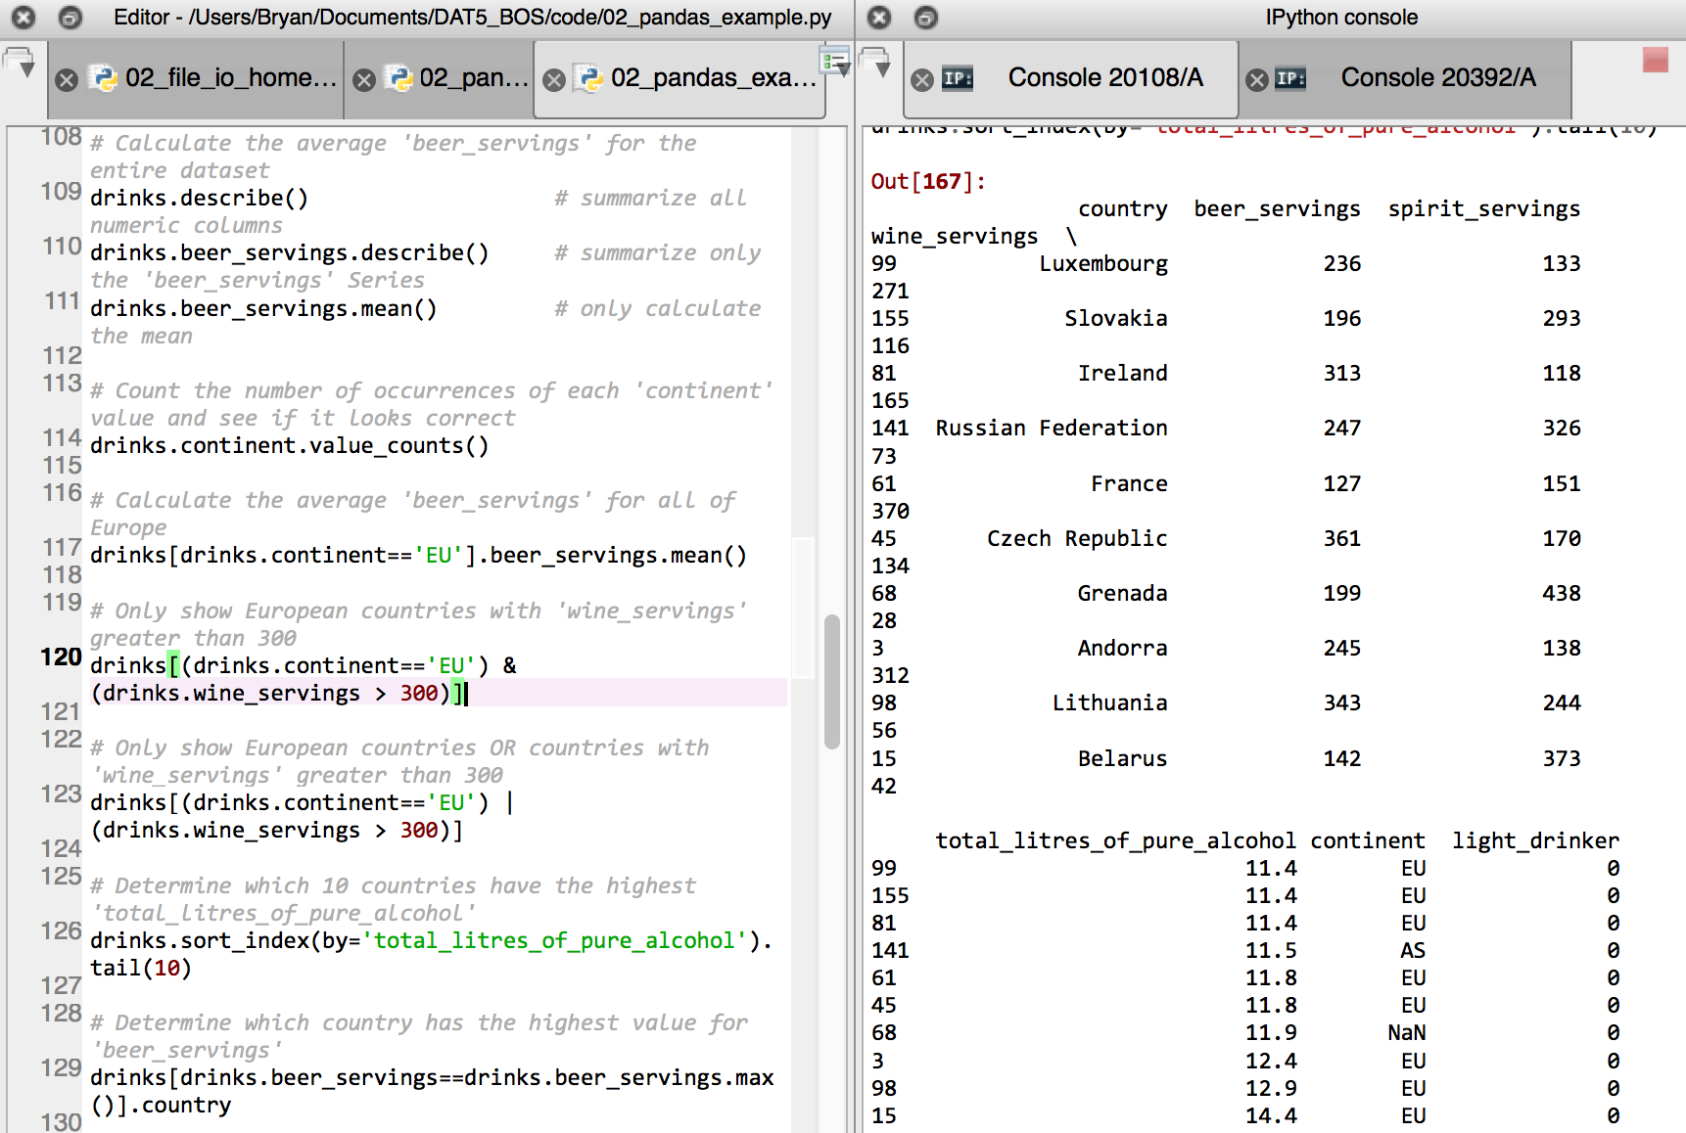
Exercise: describing and summarizing data
Summarize all numeric columns of the ‘drinks’ dataset.
Get a value count of the strings in the ‘continent’ column.
Find the mean number of beer servings for countries within the EU.
Find European countries where wine_servings is greater than 300.
Determine which 10 countries have the highest total liters of alcohol.
Determine which country has the highest number of beer servings per capita.
See mean beer servings by continent.
Find missing values in the DataFrame.
Drop missing values.
Fill missing values.

Slide 17
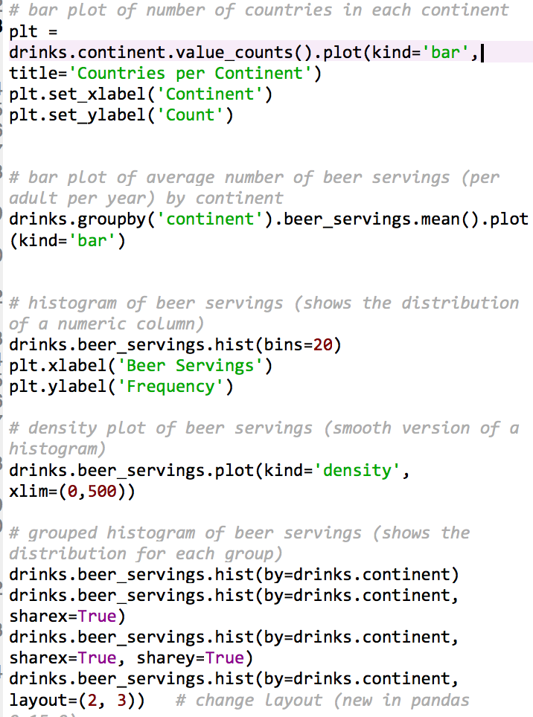
Plotting data
Pandas uses a Python package called matplotlib for its plotting.
.plot() lets you access most simple plot functions
.plot(kind = bar) is for bar plots. Other kinds are line, barh (horizontal bar), density, area, scatter, and hexbin.
You can add plot titles with the title= assignment, as well as .set_xlabel() and .set_ylabel()
.hist() lets you create histograms, with by= letting you see them by a particular group
Use .groupby() to create summary plots for a particular string or category of data (such as continent)

Slide 18
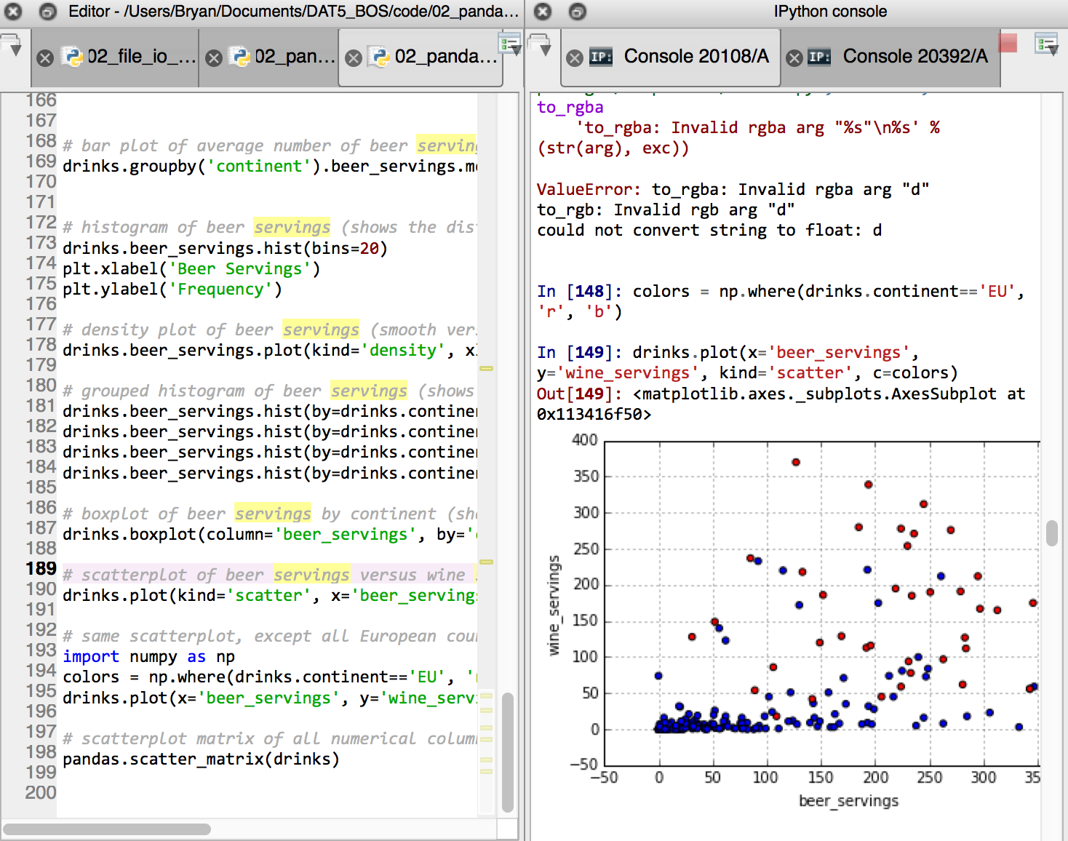
Exercise: Plotting data
Create a bar plot of the number of countries in each continent.
Create a bar plot of the average number of beer servings (per adult per year) by continent.
Create a histogram of beer servings by number of countries.
Create a density plot (a smoothed version of a histogram) of beer servings by number of countries.
Create grouped histograms of beer servings of countries by continent.
Create a box plot of of beer servings by continent.
Create a scatterplot of beer servings versus wine servings.
Create a scatterplot matrix of all numeric columns in the DataFrame.

Slide 19
HOMEWORK
Open http://nbviewer.ipython.org/github/cs109/content/blob/master/lec_04_wrangling.ipynb.
Read through the entire iPython Notebook.
As you get to each code block, copy it into your own Python script and run the code yourself. Try to understand exactly how each line works. You will run into Python functions that you haven't seen before!
Explore the data on your own using Pandas. At the bottom of your script, write out (as comments) two interesting facts that you learned about the data, and show the code you used to find those facts.
Create two new plots that show something interesting about the data, and save those plots as files. Include the plotting code at the bottom of your script.
Save your Python script and image files to your local hard drive. We will upload them to the class Git on Tuesday.

Slide 20
Questions?
USING PYTHON IN DATA SCIENCE

